Slide 1
Understanding your Property Assessment & Taxes

Slide 2
Today’s Presenters
Holly Kim
Lake County Treasurer
Charlie Mullin, CIAO
Warren Township Assessor
Karl Jackson, CIAO, SRA
Warren Township Chief Deputy
Notes:
Welcome: Introduce myself, talk briefly about how this started.
Format: Tell audience to please stay muted during the official discussion, but they can use the chat.

Slide 3
Welcome and Format
Guest Presentation
Q&A from the audience

Slide 4
Order of events
Overview of the Property Tax Cycle
Budget and Levy Process
How to read your Tax Bill
How to read your Assessment Notice
How to review your assessment
How to use SmartFile
Q&A

Slide 5
Overview of the Property Tax Cycle
Tax Bill is Made up of three Parts:

Slide 6
Overview of the Property Tax Cycle
Part of Bill
Part of Tax Cycle
Exemptions
Assessed Value
Assessment
& Valuation
Tax Rate
Budget
& Levy

Slide 7
Overview of the Property Tax Cycle

Slide 8
Overview of the Property Tax Cycle

Slide 9
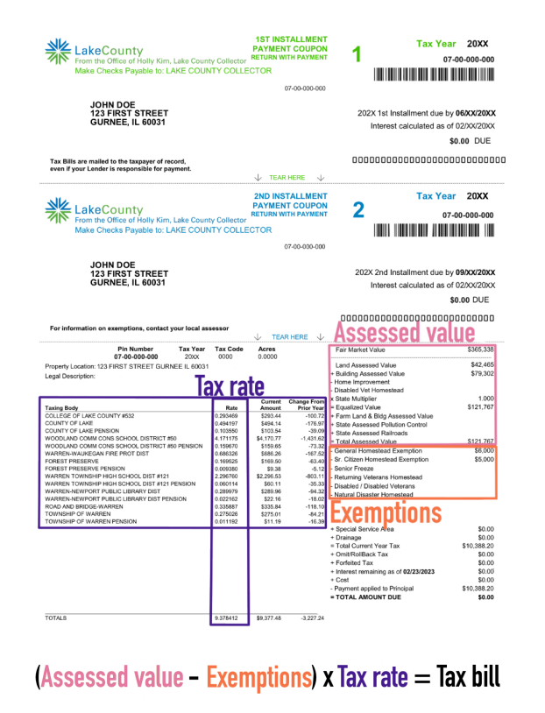
Overview of the Tax Bill

Slide 10
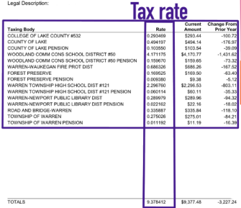
Overview Budget & Levy
Tax Rates
Are the final part of the property tax equation.
Are driven by the levy requests of each taxing body
Are determined in the Tax Extension Department of the County Clerk’s Office.

Slide 11
Overview of Exemptions
Some taxpayers may qualify for property tax exemptions such as the:
General Homestead Exemption
Senior Homestead Exemption,
Disabled Veterans Exemption,
and Disabled Persons Exemption and more.
Exemption renewals for various homestead exemptions are mailed out in the spring.

Slide 12
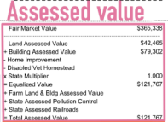
Overview of Assessment process
There are many moving parts in the property tax cycle – the assessment is just one part, your share of the overall property tax burden.

Slide 13
Overview of Assessment process
Statutory Level of Assessment & Fair Cash Value
Market Adjusted Cost Approach
Equalization

Slide 14
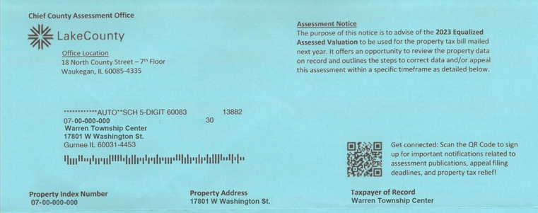
Overview of Assessment Notice

Slide 15
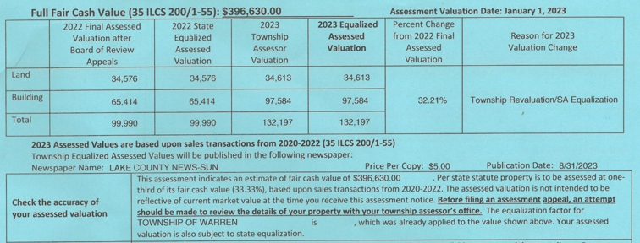
Overview of Assessment Notice

Slide 16
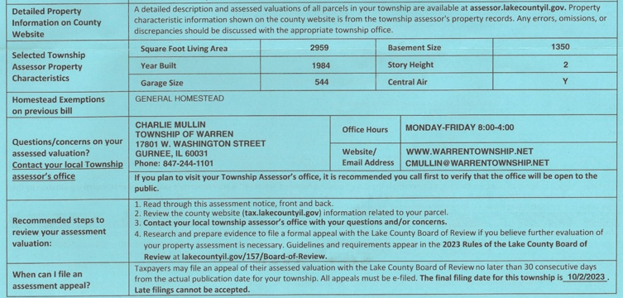
Overview of Assessment Notice

Slide 17
Live Demonstration – How to Review your Assessment
Fair Cash Value –
Comparable Selection – Sale date, units of comparison: total sale price, sale price per square foot (AGLA)
Equity –
Neighborhood Stratification
Comparable Selection: units of comparison: building and land value per square foot (AGLA)
When to file an appeal
How to Utilize SmartFile to file an assessment appeal

